Slide 1
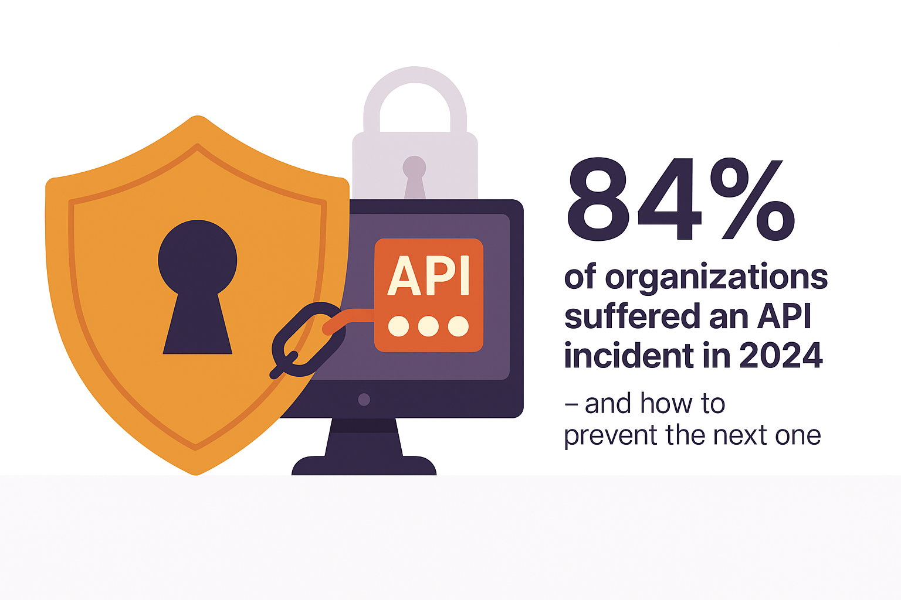
Securing the Modern API Attack Surface
Presenter: Mike Cropsey
Industry context from Akamai, Imperva, Gartner
API Infrastructure
Vulnerabilities
Protective Measures
Based on the Akamai API Security Impact Study (2024)
Notes:
According to a 2024 survey of more than 1,200 security professionals, 84% reported experiencing an API-security incident in the last 12 months.
That statistic tells us that APIs aren’t just a theoretical risk—they’re actively being hit.
So what kind of issues are we talking about?
Everything from customer-data exposure to misuse of internal services, plus the financial side: regulatory penalties and remediation costs that can exceed half a million dollars per incident.
This presentation walks through why APIs have become such a common attack surface, what API gateways can help with, where full API security platforms add protection, and how attackers exploit these weaknesses in practice.
I’ll also walk through a live demo showing real API vulnerabilities and protections.

Slide 2
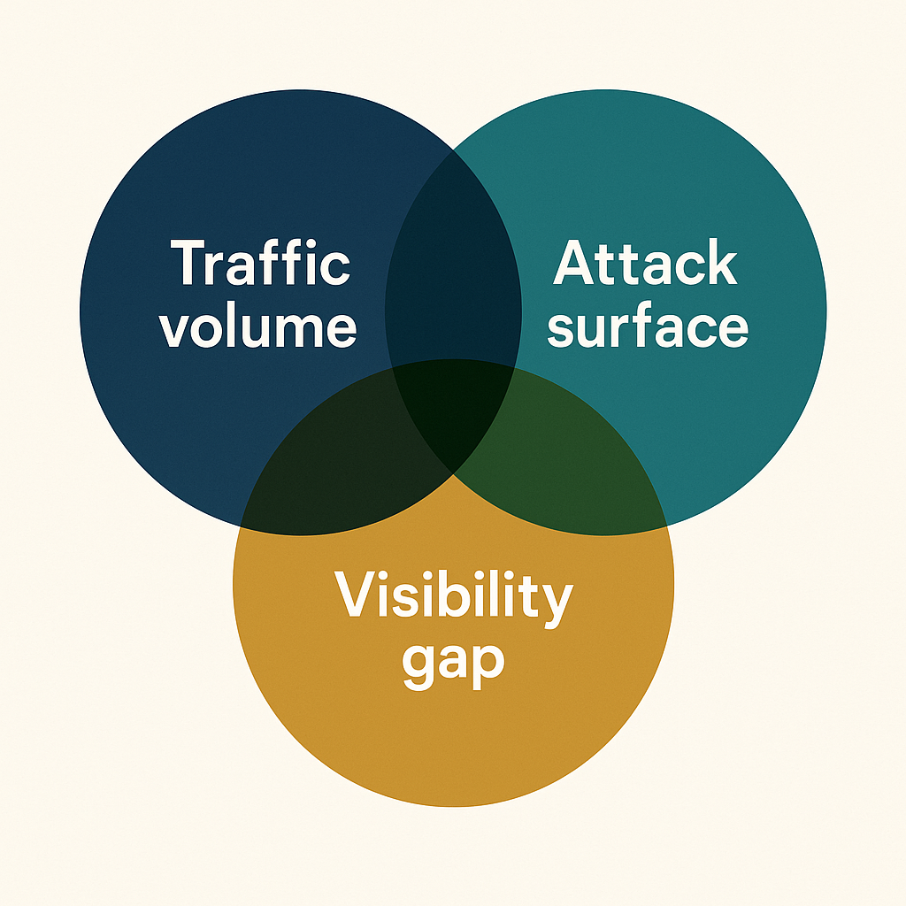
The API Explosion: 3 Truths You Can’t Ignore
APIs are the Internet
  71% of all web traffic is API-driven
    (Imperva State of API Security 2024)
  APIs are the #1 attack vector
    Gartner: “APIs now represent the leading path for attackers.”
  Organizations underestimate their API footprint
    Akamai API Security Study (2024): Only 27% of companies know their full API footprint—leaving shadow APIs as hidden, prime attack targets.
APIs now sit at the center of a perfect storm: more traffic, a bigger attack surface, and a growing visibility gap.
Notes:
APIs have become the backbone of modern applications.
The sheer number of APIs—especially internal ones—creates a visibility gap.
Most organizations underestimate the number of APIs they are actually exposing, which is where attackers begin.

Slide 3

The API Breach Pattern:
Discovery → attacker finds an unprotected API
Exploitation → sensitive data stolen or access escalated
Damage → legal, financial, and reputational impact

Slide 4
Modern Apps Depend on APIs
What You Expect: REST & GraphQL powering web and mobile features
What You Don’t See: gRPC, Webhooks, Async APIs inside microservices
What You Forgot Exists: SOAP/XML-RPC and internal “zombie” APIs
Notes:
Attackers don’t care which API style you use—REST, GraphQL, gRPC, SOAP—they all have similar risks.
Anything that exposes structured data or functions can be targeted.
uAsync APIs: APIs that accept a request immediately and process it in the background, notifying the client later instead of blocking for a response.
Webhooks: HTTP callbacks that push real-time event data from a source system to your URL the moment something happens.
Message Bus: A centralized messaging backbone (e.g., Kafka, RabbitMQ) that reliably routes, queues, and delivers events between services or applications.

Slide 5
API Security Deployment Approaches
1 — Inline or Out-of-Band?
Inline
Real-time blocking
Can add 100–200ms latency (per AWS API GW customer feedback)
Out-of-Band (OOB)
Mirrors traffic
Zero latency
Blocks via SOAR, WAF, Gateway
2 — Full or Partial Protection?
Full API Protection (Akamai Noname, Salt)
BOLA, schema validation, behavior detection
Partial Protection (Kong, Traefik, ADC APIs)
CORS, rate limiting, bot filters only
3 — Discovery or Blind Spots?
Can your system auto-detect Shadow APIs?
Notes:
This slide is focused purely on how API security is deployed—not what any specific vendor does.
There are two core technical models:
Inline security sits in front of APIs and enforces rules in real time. It’s powerful for blocking but can introduce latency and requires careful routing and reliability considerations.
Out-of-band security mirrors traffic instead of intercepting it. This gives full visibility with zero performance impact and works extremely well in Kubernetes and microservice environments. Blocking still happens, but it’s triggered through your gateway, WAF, or SOAR system.
Once you understand the deployment model, the next question is protection level:
API gateways generally offer partial protection—good at rate limits and coarse controls—but they lack the depth for logic-level issues.
Full platforms add behavioral analysis, object-relationship awareness, authorization context, and anomaly detection.
The final piece is discovery.
Most breaches begin with APIs the organization didn’t know they were exposing—internal services, legacy endpoints, developer/test APIs, or routes left behind after a code refactor.
Discovery is the foundation for any API security strategy.

Slide 6
Three Layers of API Identity: Authentication Authorization Context
Many API incidents don’t happen because authentication fails. They happen because authorization fails.
Most gateways and basic API protections validate the token and stop there. They don’t check things like:
Is this user supposed to access this specific object?
Does this request match normal behavior?
Is this parameter referencing someone else’s data?
Notes:
“We’ve talked about API growth, deployment approaches, and even the attack chain. But there’s a specific reason why attacks like BOLA keep succeeding, even in environments with good authentication, good gateways, and good traffic controls.”
“Here’s the core issue: most API incidents don’t happen because authentication fails.
They happen because authorization fails.
When an attacker logs into an API with a valid JWT or OAuth token, the system assumes the request is trustworthy — but the token only proves who they are, not what they should be allowed to do.
Most gateways and basic API protections validate the token and stop there.
They don’t check things like:
Is this user supposed to access this specific object?
Does this request match normal behavior?
Is this parameter referencing someone else’s data?
That gap between authentication and authorization is exactly what makes attacks like BOLA, Mass Assignment, and Excessive Data Exposure so common.

Slide 7
OWASP API Threat Examples
Broken Access Control
BOLA, Mass Assignment, privilege escalation
Excessive Data Exposure
APIs returning far more data than intended
Weak Security Controls
CORS misconfig, no rate limits, resource exhaustion
https://owasp.org/API-Security/editions/2023/en/0x11-t10/
Notes:
These are not theoretical or niche cases.
These are the issues that regularly bypass WAFs, firewalls, and unconfigured API gateways
Purpose of CORS
Browsers block requests between different domains by default for security.
CORS provides a controlled, safe way to allow those cross-domain requests when needed.
Real-World Use Cases
Allowing your frontend app on app.company.com to call an API on api.company.com
Letting a third-party service access your API safely
Preventing malicious websites from making unauthorized requests to your server
Enforcing rules like which HTTP methods are allowed (GET, POST, etc.)
In API Security Context
CORS reduces risk by ensuring only approved origins (websites) can call your API from a browser.
But it does NOT stop API attacks, because attackers don’t use browsers—they use tools like curl, Postman, Burp Suite, etc.

Slide 8
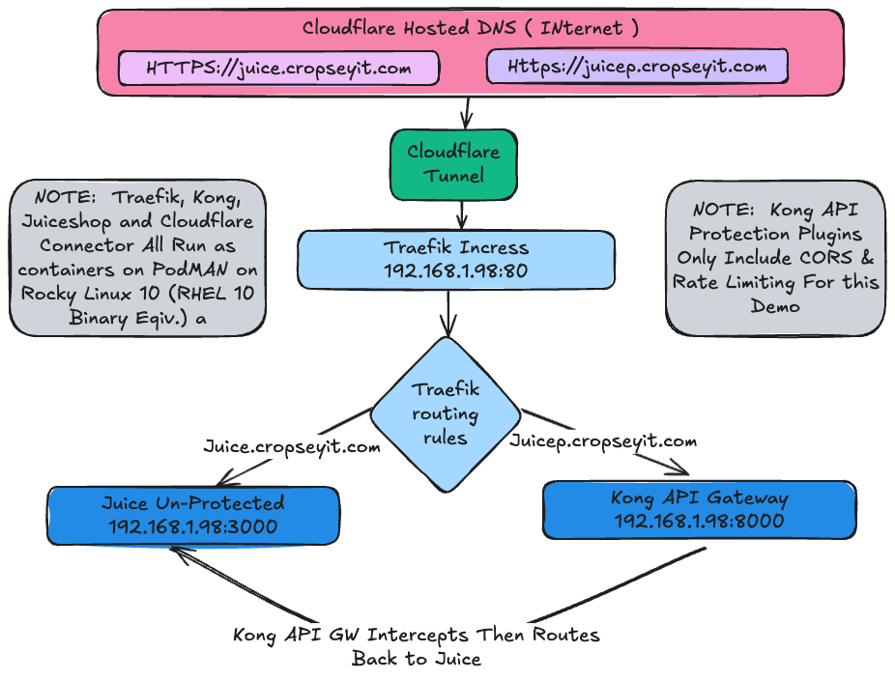
LIVE DEMO
Notes:
LIVE DEMO
Your Talk Track:
“Next I’ll show a live demo of real API attacks on Juice Shop —
BOLA, excessive data leaks, CORS misconfig, and more.
This is exactly what attackers run against real businesses every day.”

Slide 9
Where API Gateways Help
Control Traffic
  Rate limiting, throttling, and routing help manage load and prevent abuse.
Enforce Basic Hygiene
  Validate requests, enforce CORS, and standardize headers before they hit services.
Add Lightweight Protections
  Bot filtering, JWT checks, and plugin-based rules provide simple, optional security layers.
Notes:
Gateways are essential operational components.
They provide the first line of filtering and traffic shaping.
They stop a variety of common problems—but not the logic-level attacks.

Slide 10
Where API Gateways Stop
No Object-Level Awareness
  Gateways don’t understand IDs or schemas → can’t detect BOLA or improper data access.
No Behavior Insight
  Every request looks the same → no anomaly or misuse detection.
Inconsistent Protection
  Plugin-heavy, manual rules → human error and uneven coverage.
Notes:
These limitations are not flaws—they’re simply not what gateways are built for.
Gateways handle the “plumbing,” not the logic.

Slide 11
Akamai
API Security
**Full Visibility**
  Auto-discovers shadow, zombie, legacy & AI APIs
  Full inventory: schemas, objects, data flows, logic
**Real-Time Risk Intelligence**
  ML detects anomalies (leakage, bots, abuse)
  OWASP Top 10 + impact-based prioritization
**Flexible Protection**
  Out-of-band monitoring
  Inline blocking via App & API Protector
  Integrates: gateways, WAFs, SIEM/ITSM/SOAR
Notes:
1. Full Visibility • Automatically discovers shadow, zombie, and unmanaged APIs (including legacy and AI-related) • Builds comprehensive inventory with schema, object details, and visualizations of data flows, business logic, and traffic patterns
2. Real-Time Risk Intelligence • Uses machine learning to learn API usage patterns and flag anomalies (e.g., data leakage, tampering, suspicious bots, attacks) • Analyzes for OWASP Top 10 risks and prioritizes vulnerabilities by impact for rapid remediation
3. Flexible Protection Anywhere • Supports out-of-band monitoring for real-time analysis; inline blocking via integration with App & API Protector • Integrates with API gateways, WAFs, SIEMs, ITSM tools, and SOAR workflows for remediation

Slide 12
3 Things to Take With You
You Can’t Secure What You Can’t See
  Discovery is the foundation of every mature API security program.
Gateways Aren’t Enough
  Use them for traffic control, but rely on deeper object-level validation for real protection.
Continuous Verification Wins
  Monitor behavior in real time to catch misuse, misconfigurations, and high-risk API calls early.
Notes:
Visibility, behavior, and logic enforcement are the three pillars of API security.
This is the fastest, most reliable way to reduce risk and avoid becoming part of next year’s incident statistics.
“Traditional security tools often protect only at the endpoint level. But modern API attacks—especially BOLA, mass assignment, and excessive data exposure—happen at the object level. That means we need protections that understand how users interact with specific objects (like baskets, accounts, or records), detect abnormal behavior, and block requests that violate expected user-object relationships. Behavior-based intelligence fills the gaps left by signature-based or static rule-based systems.”

Slide 13

Question and Answers

